Slide 1

Automatically Detecting Children Excessive Internet Use on Smartphones
Zhiping Fu
Weiwei Li
Jinhong Cui

Slide 2
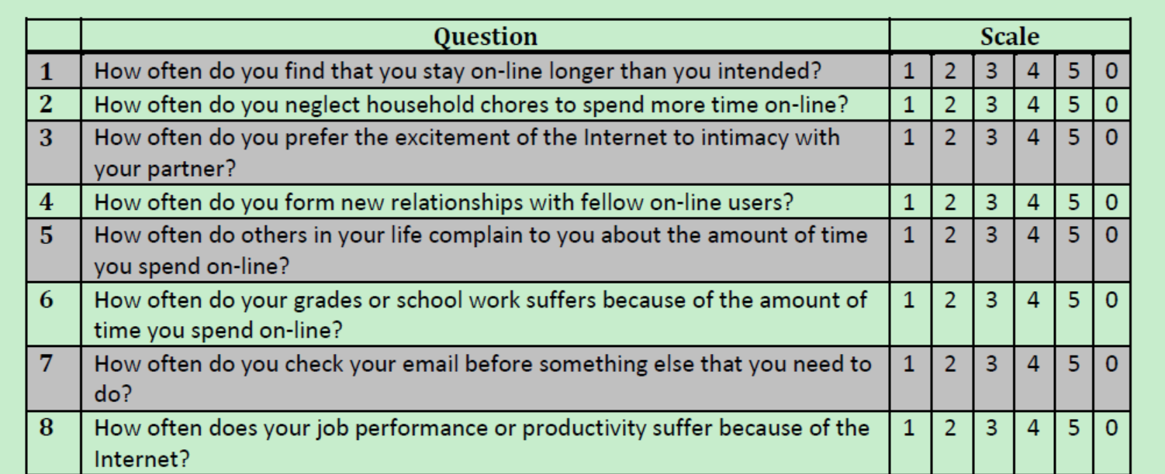

Slide 3

memory test picture from Internet

Slide 4
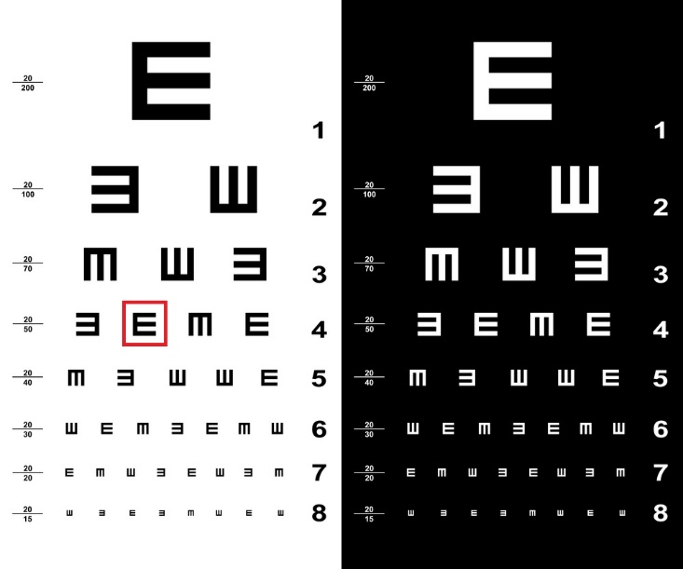
E-chart from Internet

Slide 5
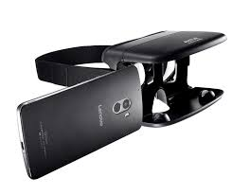
VR headset from Internet

